Slide 1
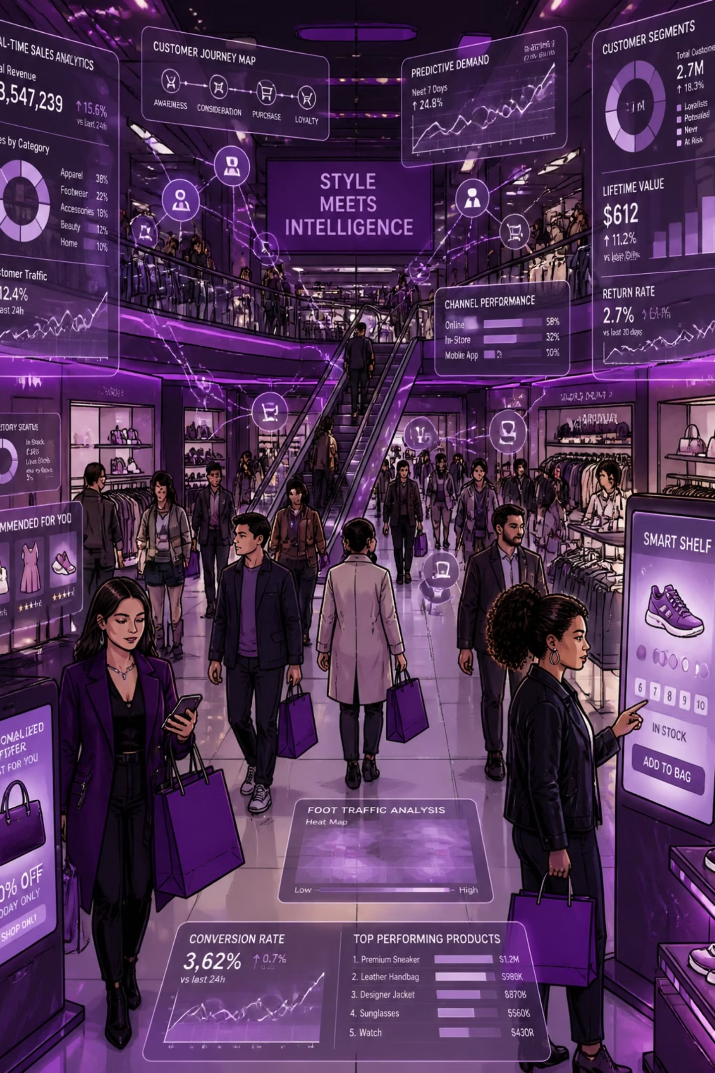
Customer Shopping Behavior Analysis
Uncovering spending patterns, customer segments, and product preferences from 3,900 transactions to guide strategic decisions.

Slide 2
Dataset at a Glance
3,900
18
Transactions
Features
37
$59.76
Missing Values
Avg Purchase
Review Rating column
Features include demographics, purchase details, and shopping behavior signals — discounts, promos, frequency, and ratings.

Slide 3
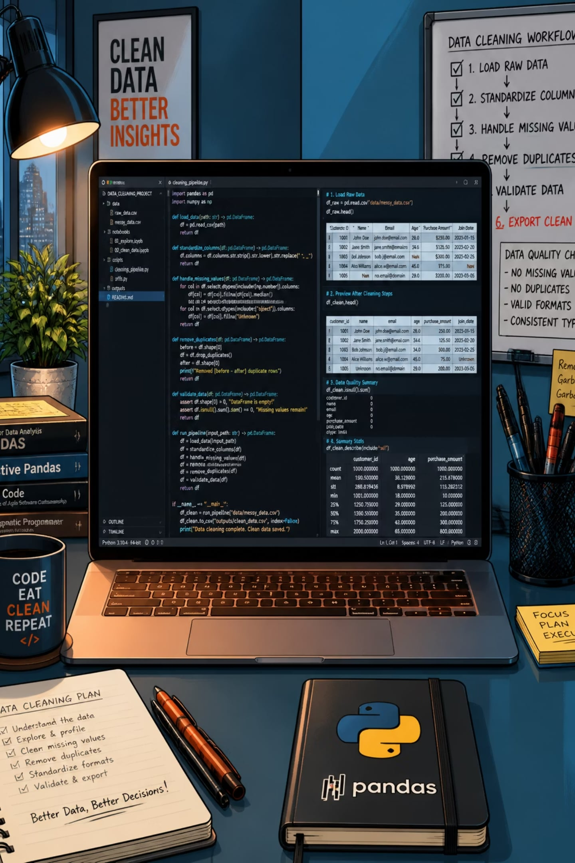

Data Preparation in Python
Clean & Standardize
Imputed missing ratings by category median; renamed columns to snake_case
Feature Engineering
Created age_group bins and purchase_frequency_days
Database Ready
Dropped redundant promo_code_used; loaded cleaned data into PostgreSQL

Slide 4
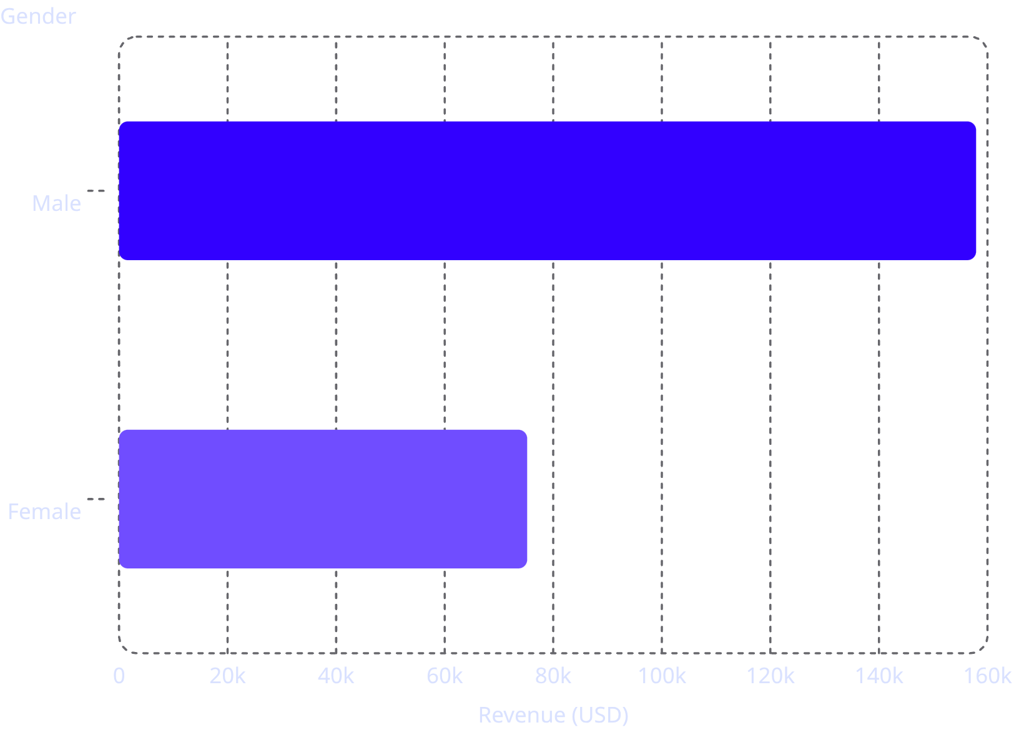
Revenue by Gender
Key Insight
Male customers generate 2.1× more revenue than female customers — a significant gap worth investigating.

Slide 5
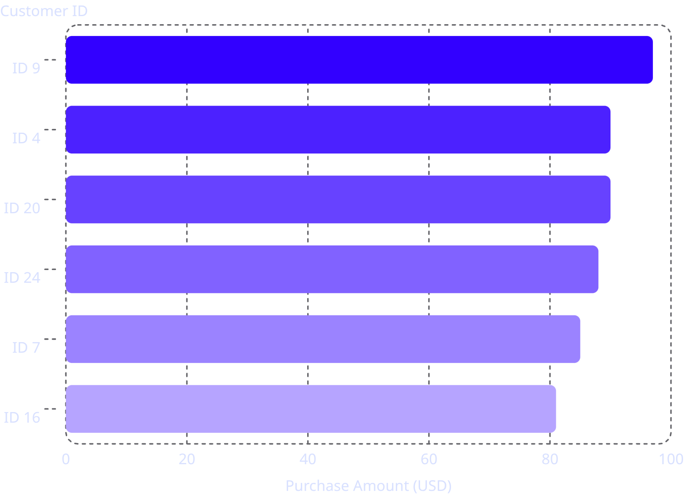
High-Spending Discount Users
Who Are They?
Customers who used discounts but still spent above average — 839 customers identified.
Top spenders ranged from $62 to $97 per transaction despite using discounts.

Slide 6
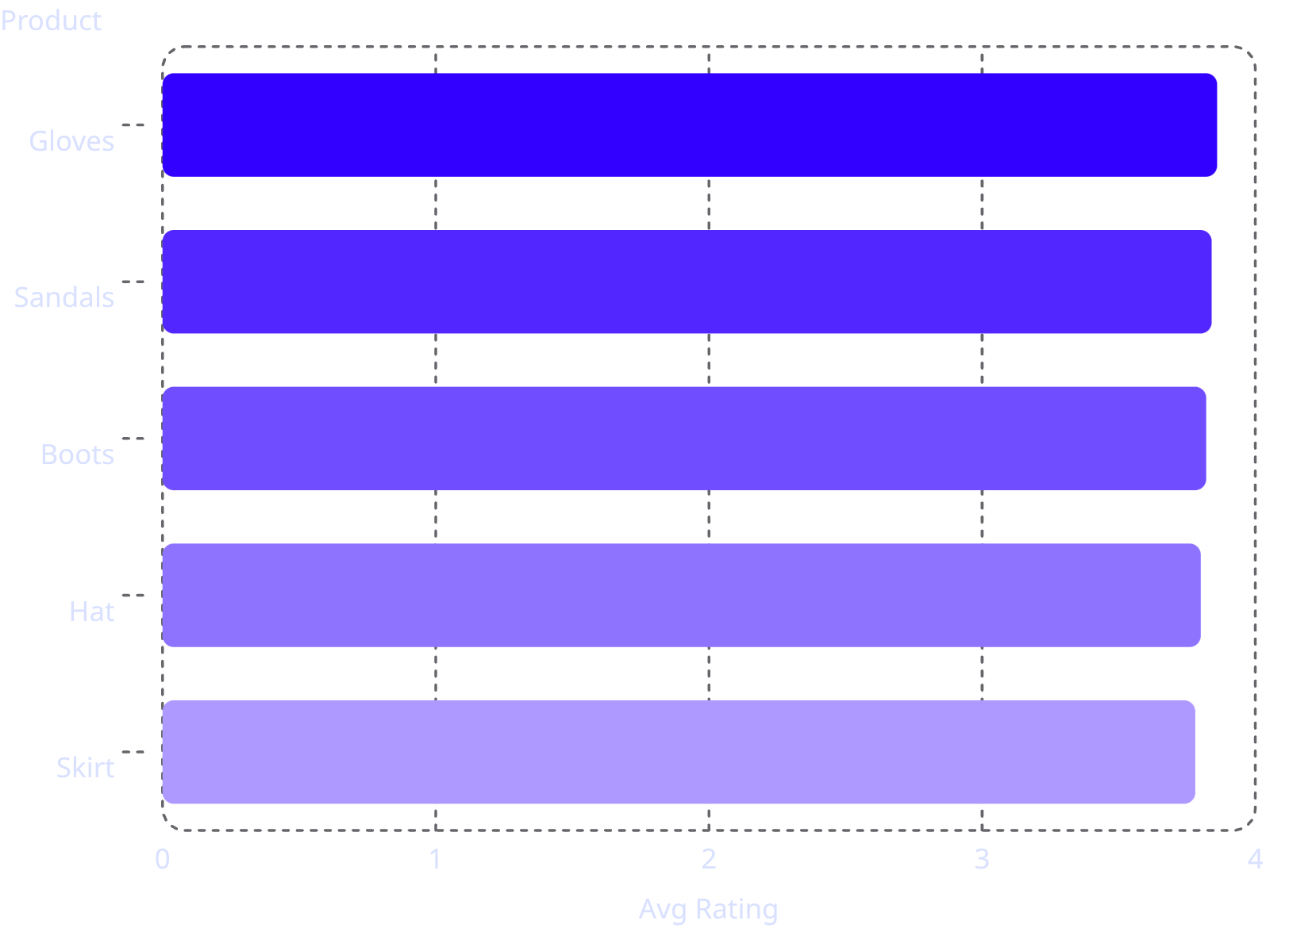
Product Ratings & Shipping
Top 5 Products by Rating
Shipping Type Comparison
Standard
Express
$58.46 avg
$60.48 avg
Express shipping customers spend slightly more on average.

Slide 7
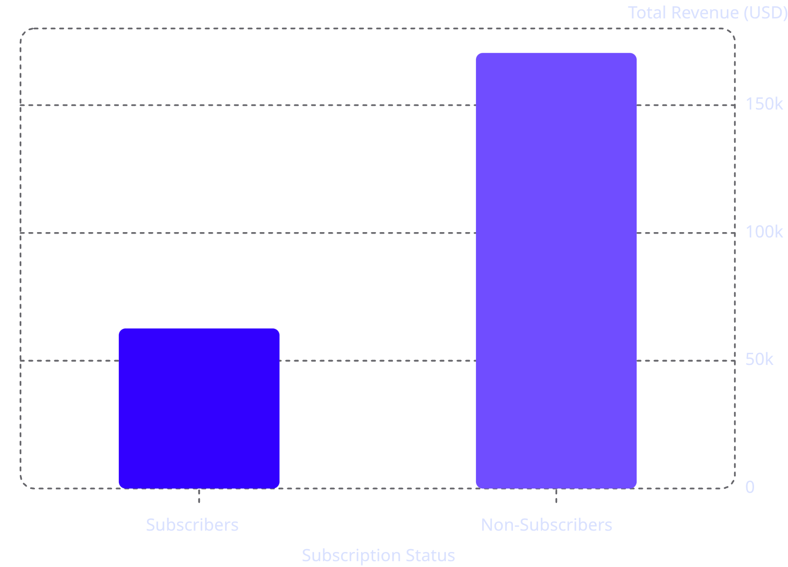
Subscribers vs. Non-Subscribers
The Gap
Non-subscribers drive 73% of total revenue despite similar average spend (~$59).
Only 27% of customers are subscribed — a major growth opportunity.

Slide 8
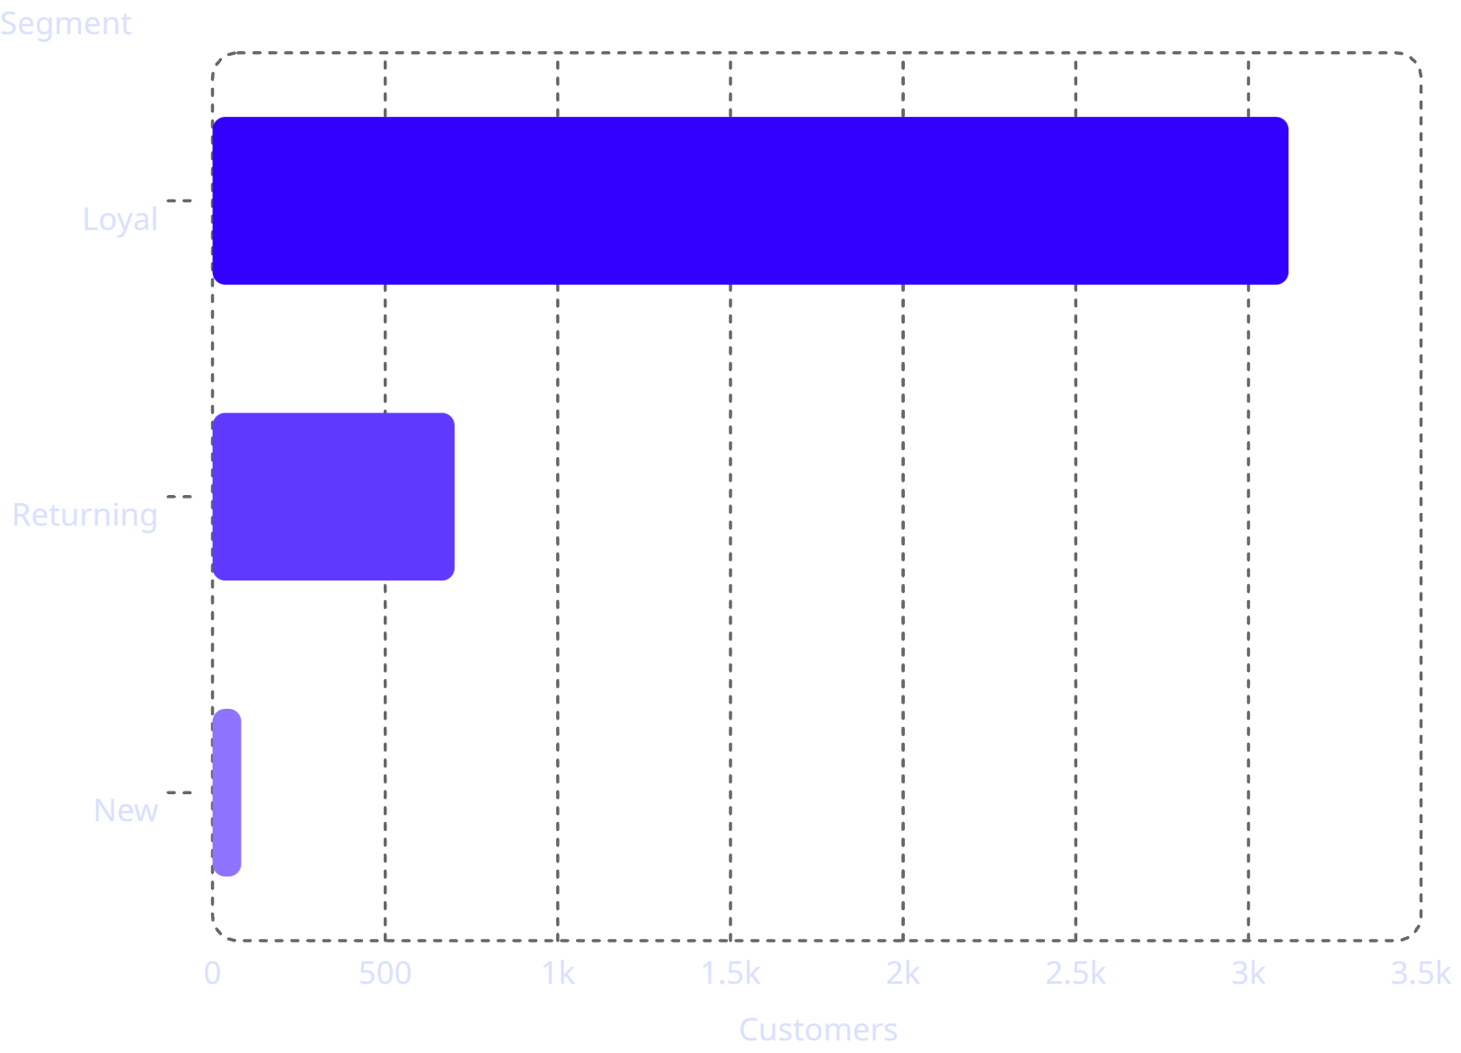
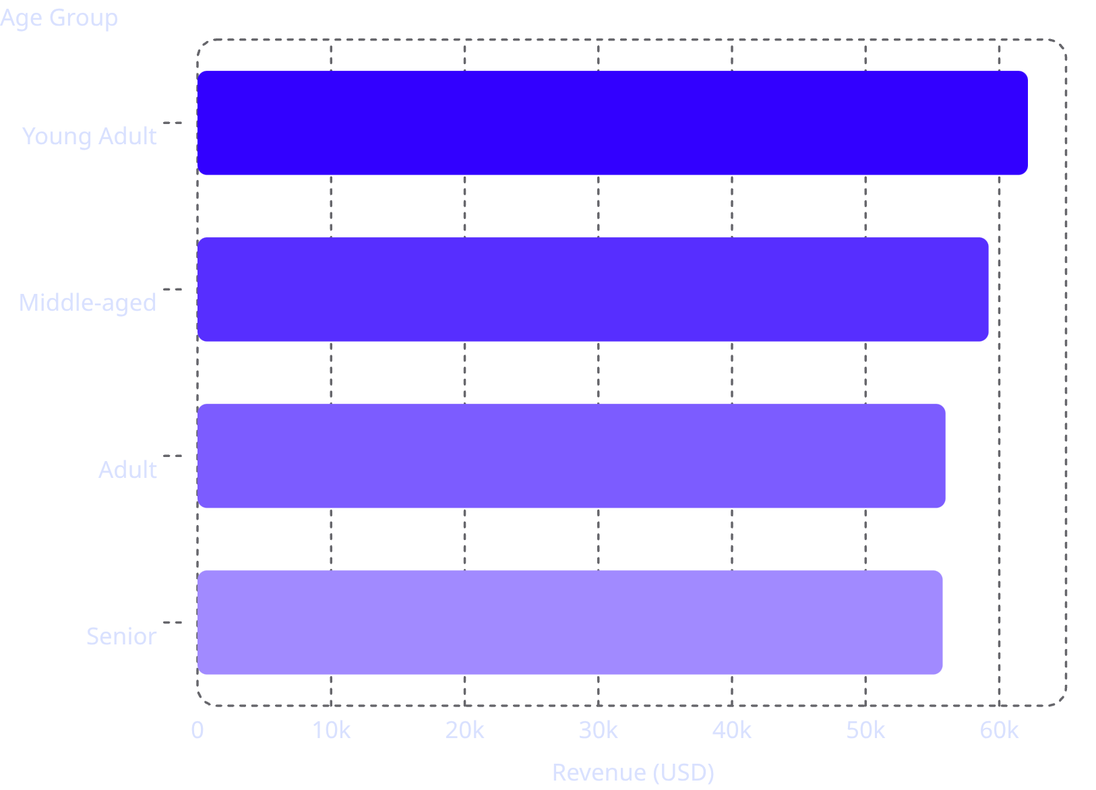
Customer Segmentation & Revenue by Age
Customer Segments
Revenue by Age Group

Slide 9
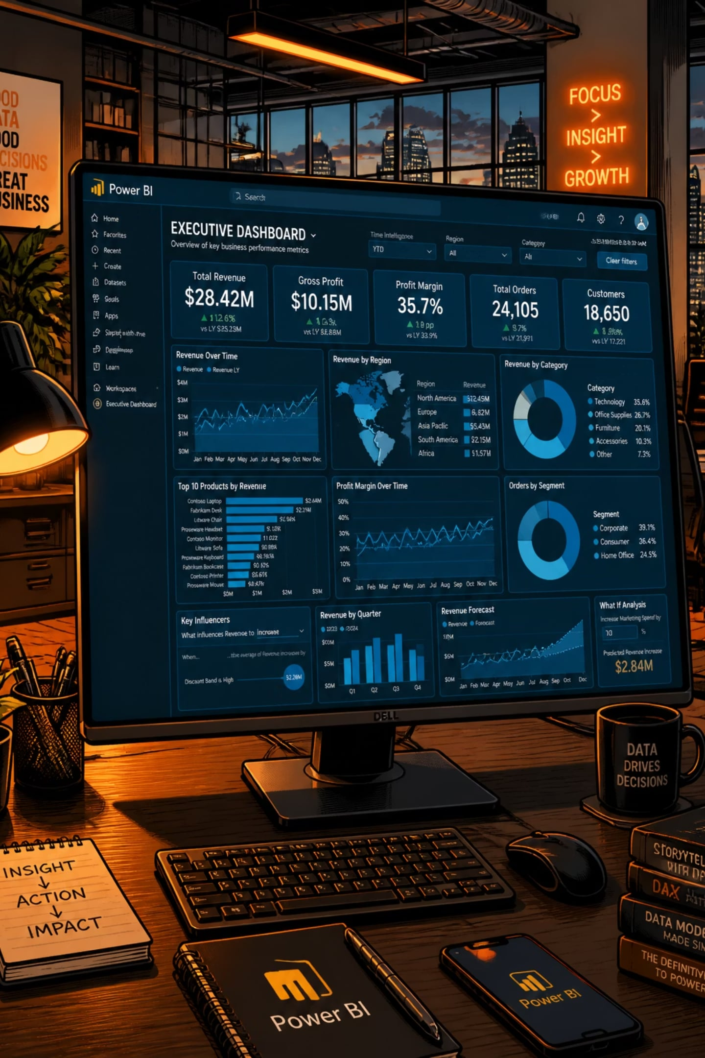
Power BI Dashboard
Filters
Visualizations
Subscription, Gender, Category, Shipping
Revenue by category & age group; sales counts
Key Metrics
3.9K customers · $59.76 avg · 3.75 rating

Slide 10





Business Recommendations
Boost Subscriptions
Loyalty Programs
Review Discount Policy
Promote exclusive subscriber benefits
Reward repeat buyers toward "Loyal" segment
Balance sales lift with margin control
Targeted Marketing
Product Positioning
Focus on high-revenue age groups & express-shipping users
Highlight top-rated & best-selling products in campaigns

